Slide 1
FCNM

Slide 2
Ingress
Egress
Input Buffer
Output Buffer
Blocking
Head of Line Blocking (HOL – B)
Virtual Output Queuing (VOQ)

Slide 3


Slide 4
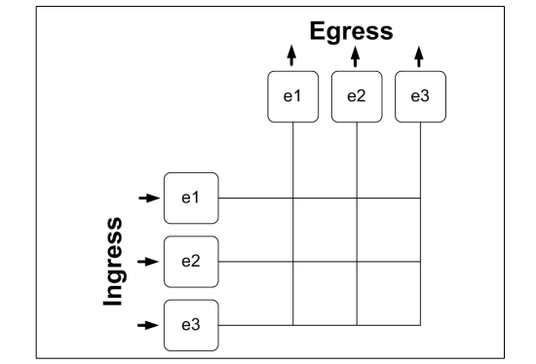

Slide 5
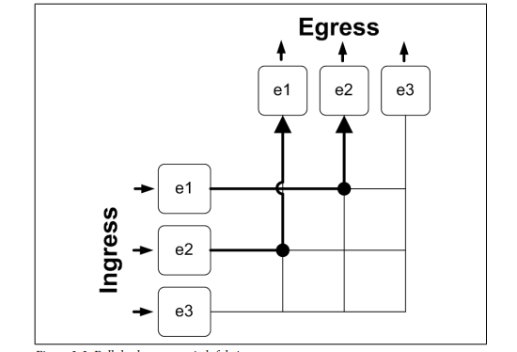

Slide 6
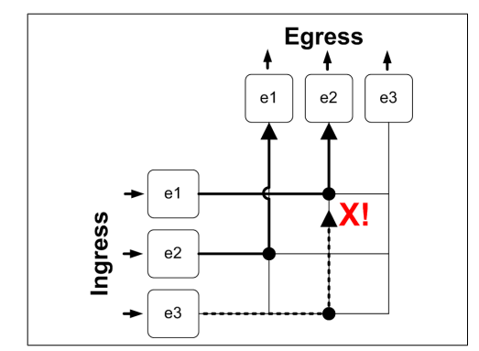

Slide 7
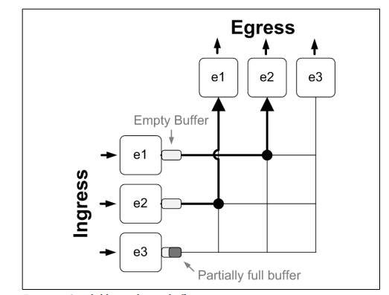

Slide 8
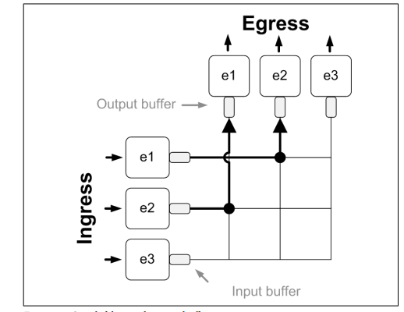

Slide 9
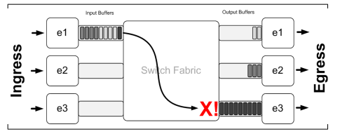

Slide 10
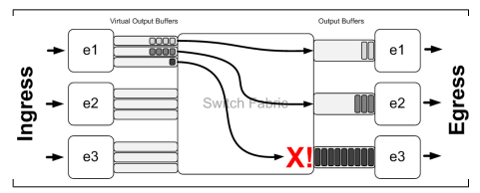

Slide 11
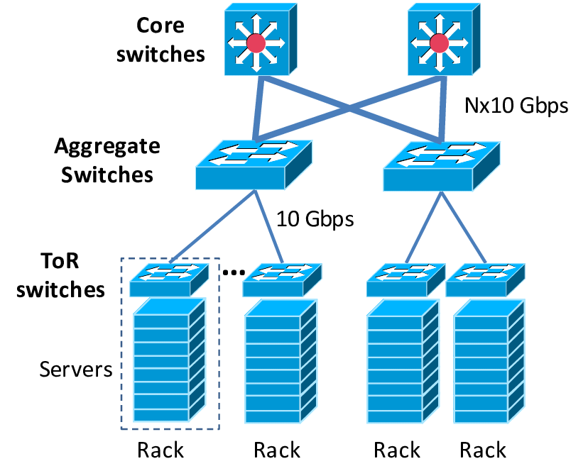

Slide 12
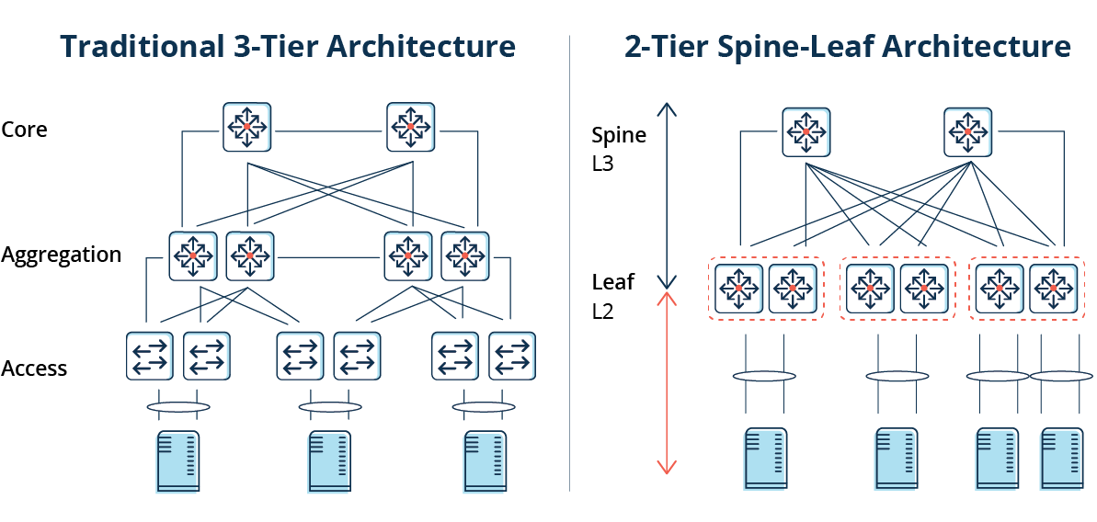

Slide 13
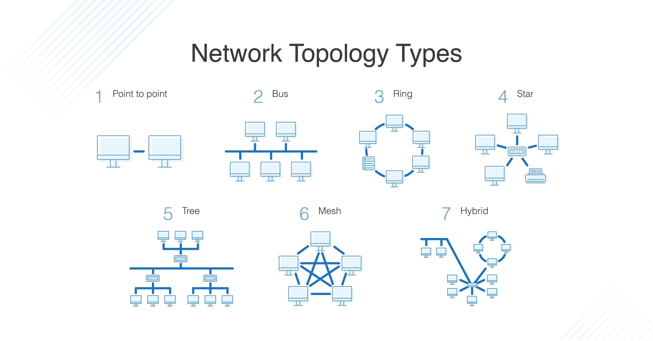

Slide 14


Slide 15
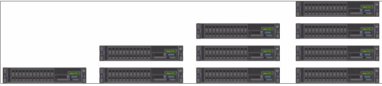

Slide 16
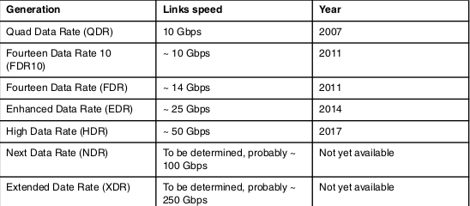

Slide 17
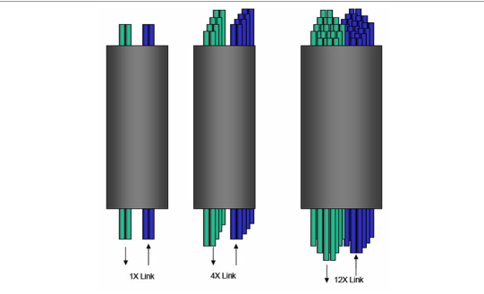

Slide 18


Slide 19
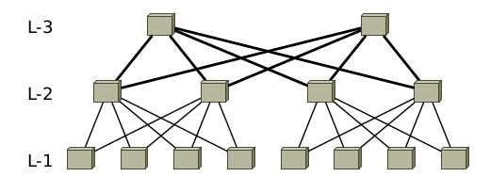

Slide 20
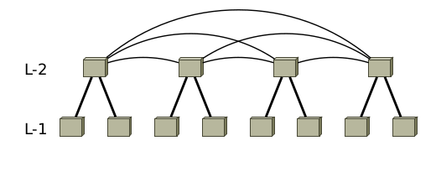

Slide 21
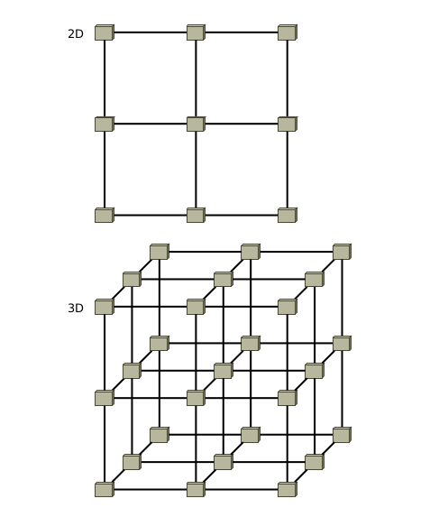

Slide 22
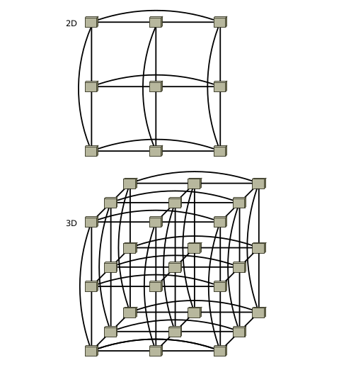

Slide 23
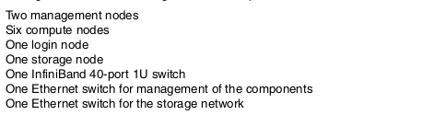

Slide 24
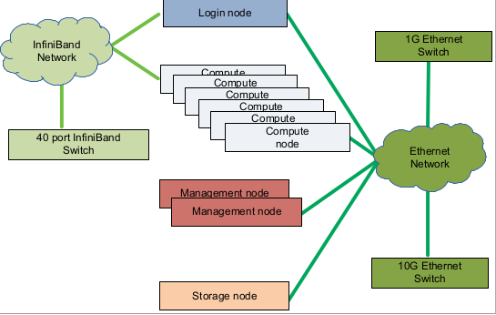

Slide 25
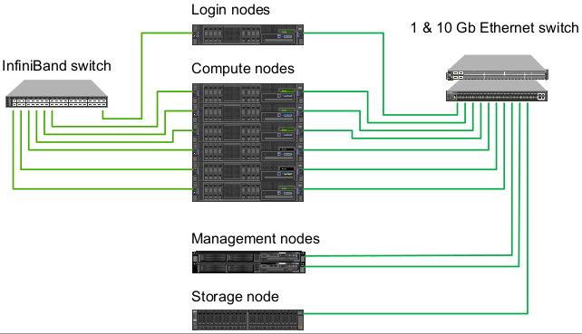

Slide 26
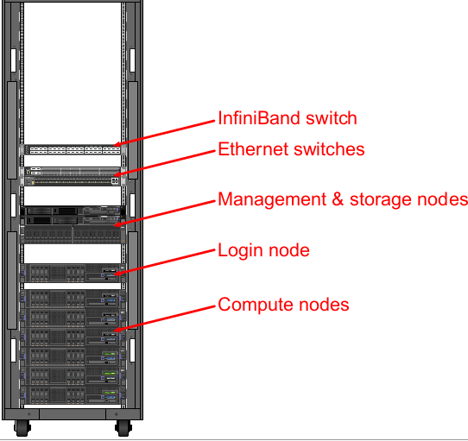

Slide 27
sudo apt-get install opensm
Nodes in the InfiniBand network will communicate using LIDs rather than IP addresses
The Subnet Manager will handle the assignment and routing of LIDs
GUIDs (Globally Unique Identifiers), on the other hand, are pre-assigned to InfiniBand devices (like Host Channel Adapters and switches) during their manufacturing
Global Identifier used for addressing in unicast, multicast and routing between two infiniband subnets

Slide 28
nmcli connection add type infiniband con-name mlx4_ib0 ifname mlx4_ib0 transport-mode Connected mtu 65520
nmcli connection modify mlx4_ib0 ipv4.method manual ipv4.addresses 192.0.2.1/24 ipv4.gateway 192.0.2.254 ipv4.dns 192.0.2.200 ipv4.dns-search example.com
nmcli connection up mlx4_ib0
ping -c5 192.0.2.2

Slide 29
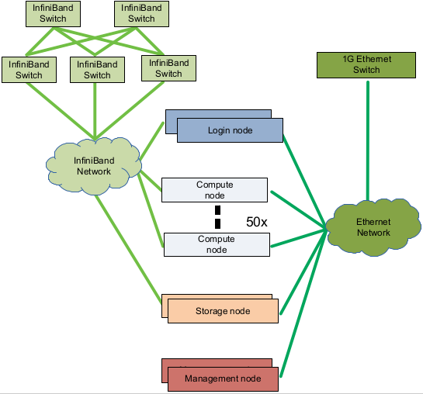

Slide 30
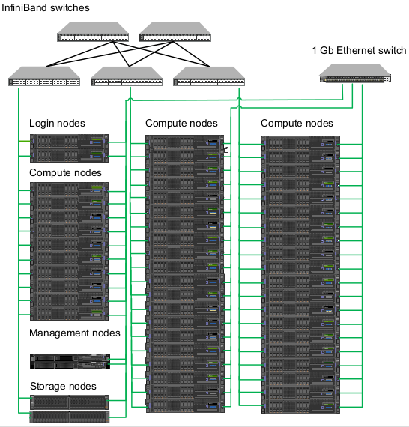

Slide 31
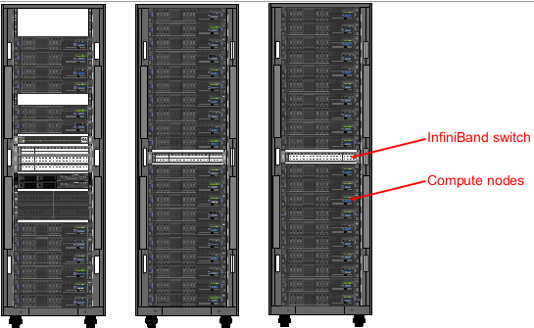

Slide 32
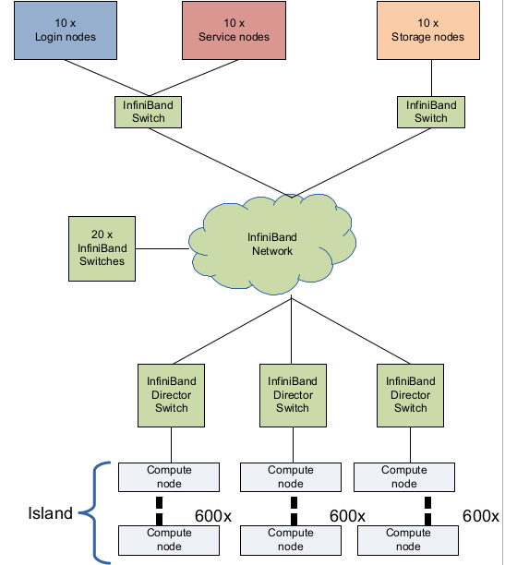

Slide 33
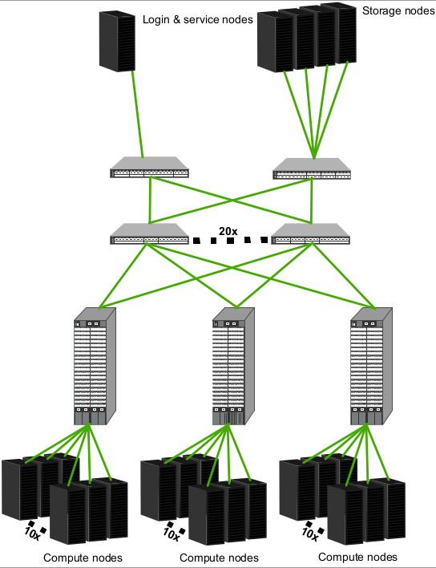

Slide 34
sudo apt-get update
sudo apt-get install rdma-core -y
sudo apt install ibverbs-utils -y
ibv_devices
ibv_devinfo
sudo ip link set dev eth0 mtu 9000
sudo ip link set dev eth0 up
lspci | grep -i infiniband
lspci | grep -i rdma
sudo ethtool -i <interface_name>
sudo dmesg | grep -i iwarp

Slide 35
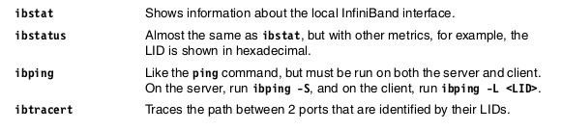

Slide 36
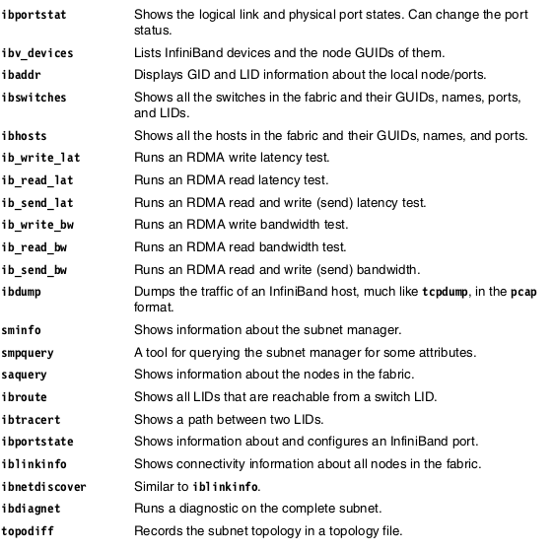

Slide 37
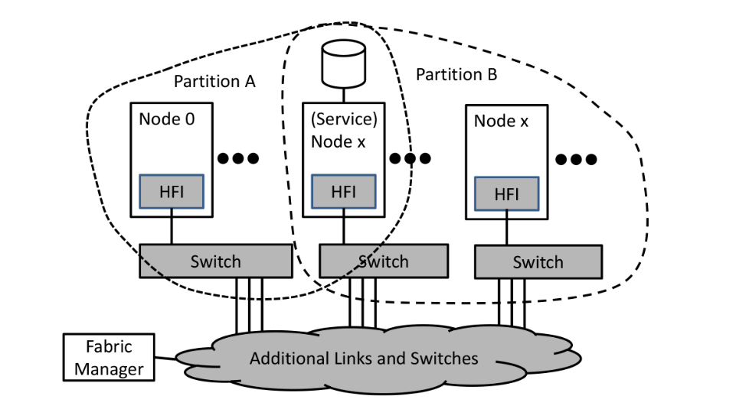

Slide 38
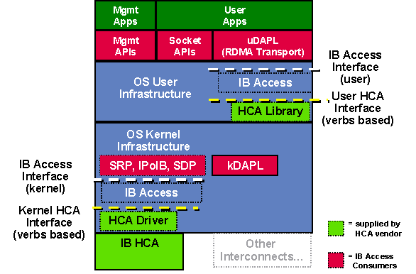

Slide 39
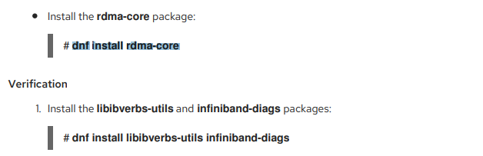

Slide 40
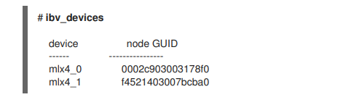

Slide 41
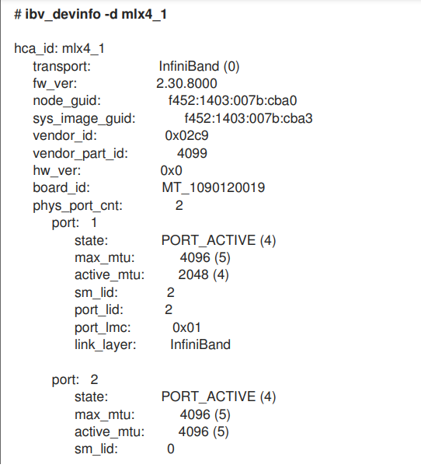

Slide 42
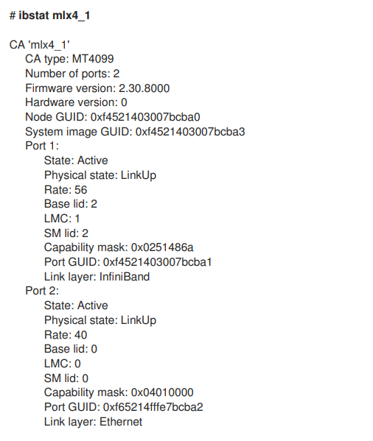

Slide 43
